Slide 1
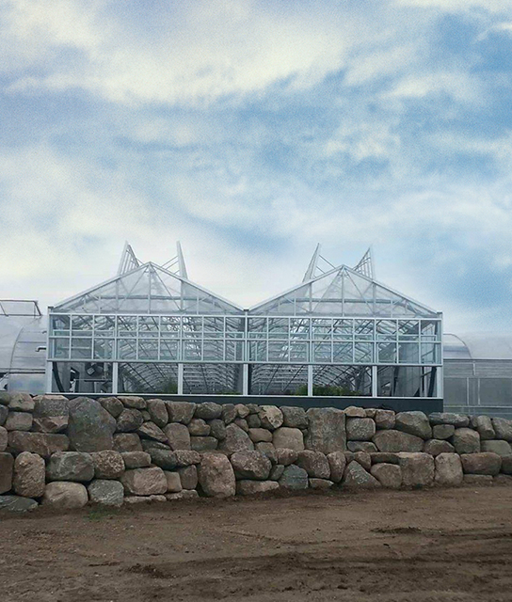
Griffin Greenhouse Supplies 2025 Fall Companion Plants
Date: june 2025

Slide 2

Fall Combination Planters

Slide 3
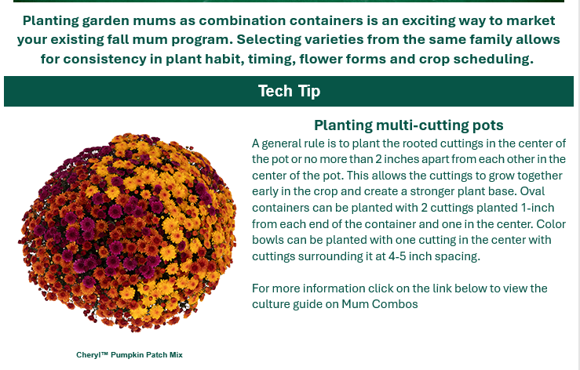

MUMS Syngenta Combos

Slide 4
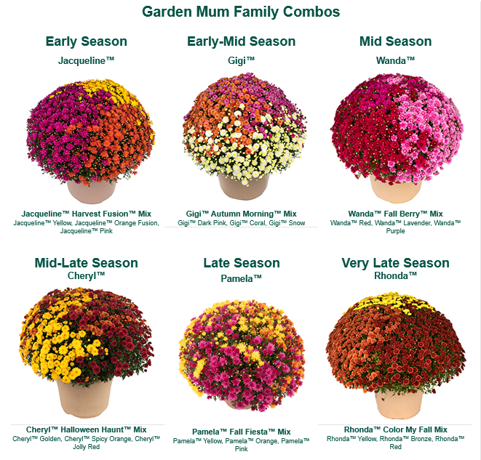
Syngenta Families for Every Season

Slide 5
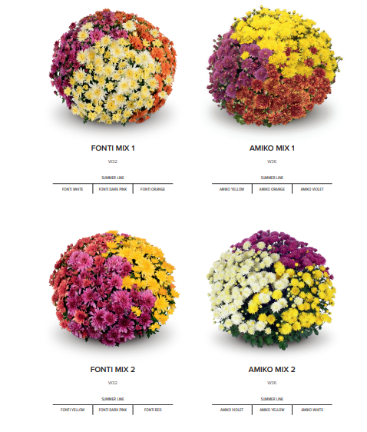
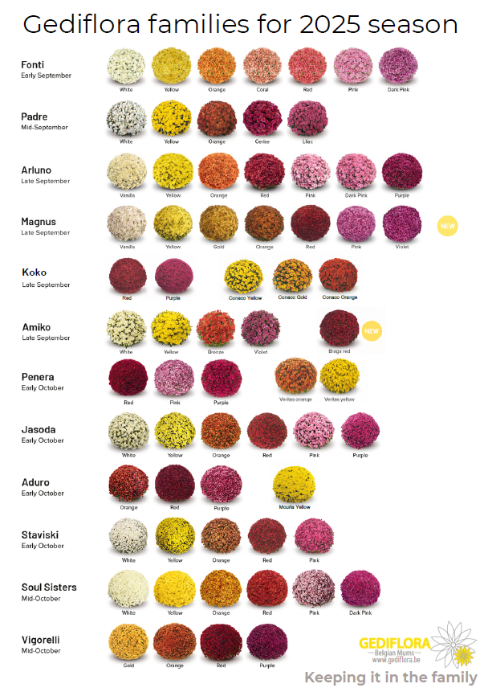


Slide 6
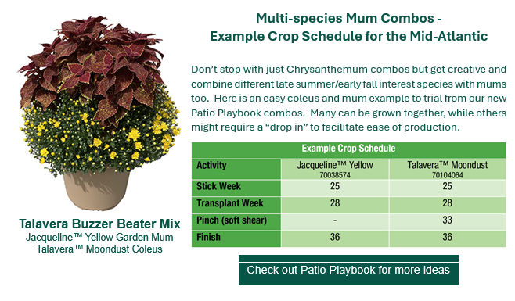
Multi-species Mum Combos

Slide 7
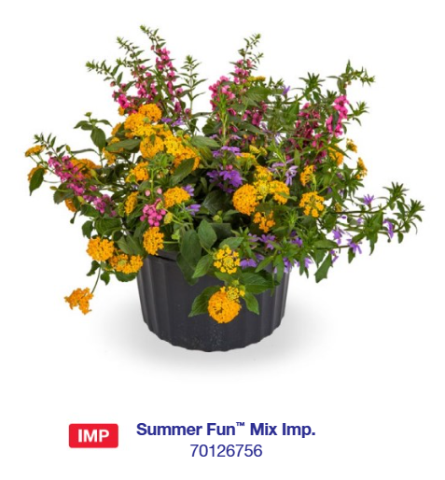
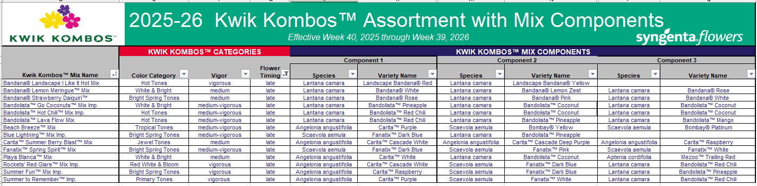
Kwik Kombos for Summer/Fall
Heat Loving Combinations

Slide 8
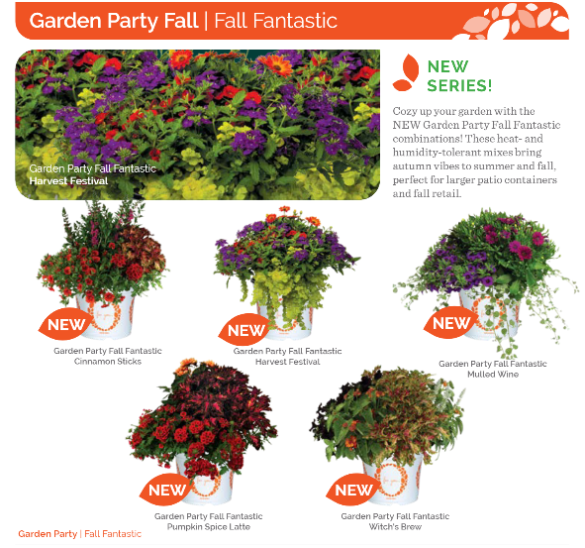


Slide 9
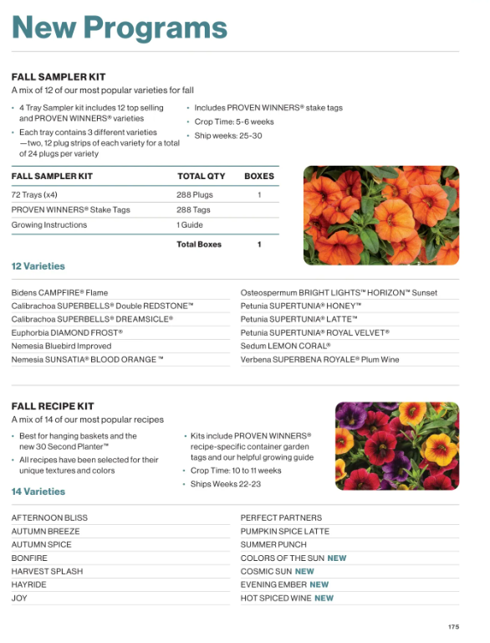


Slide 10
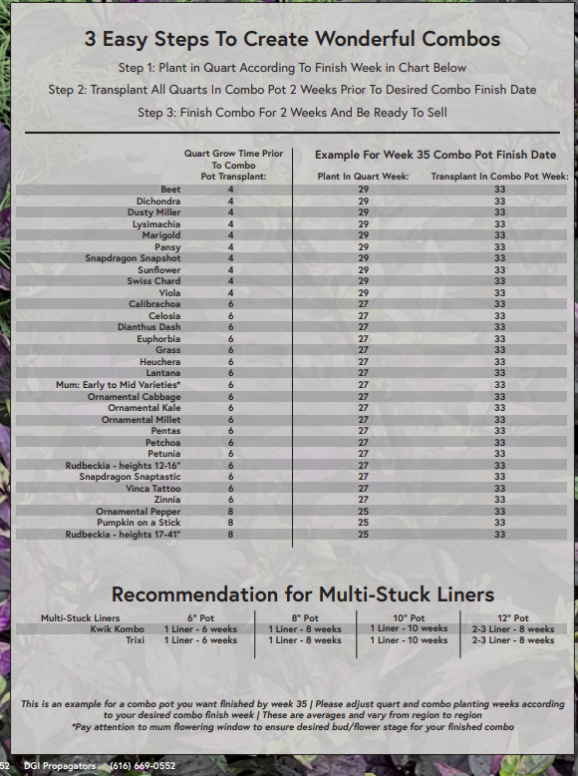
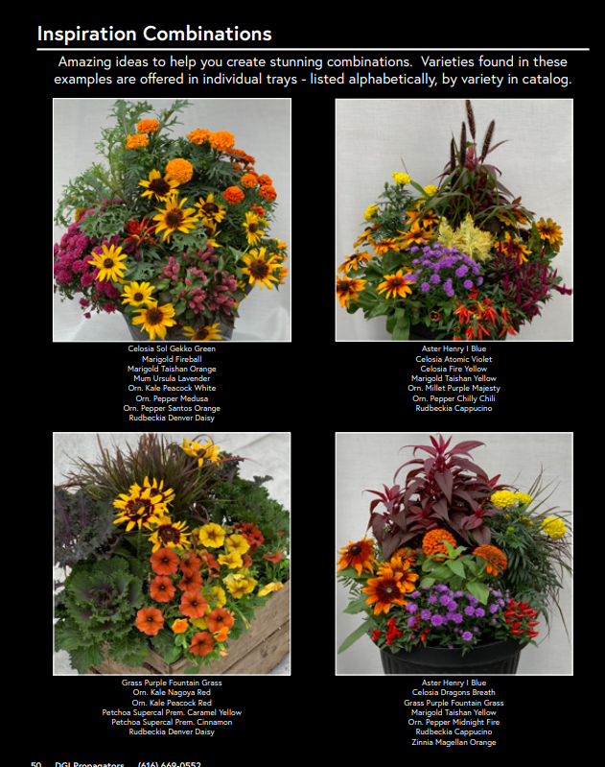


Slide 11
Annuals

Slide 12
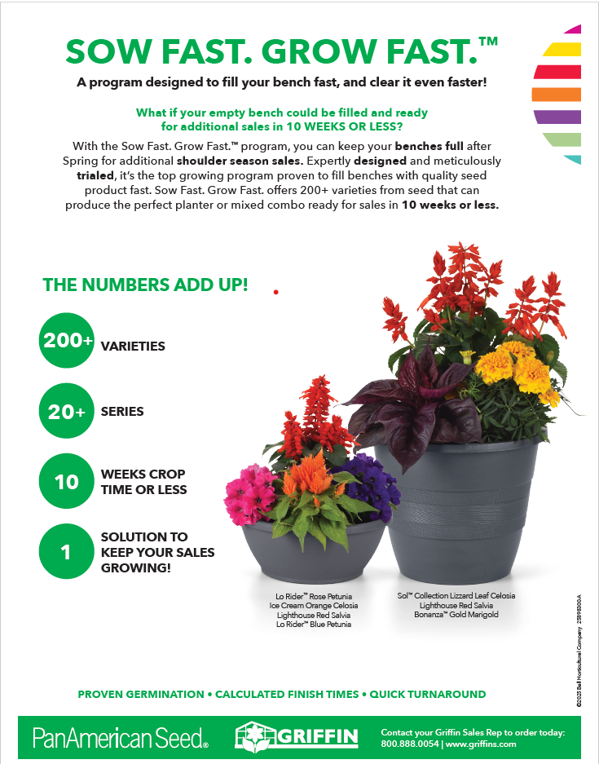
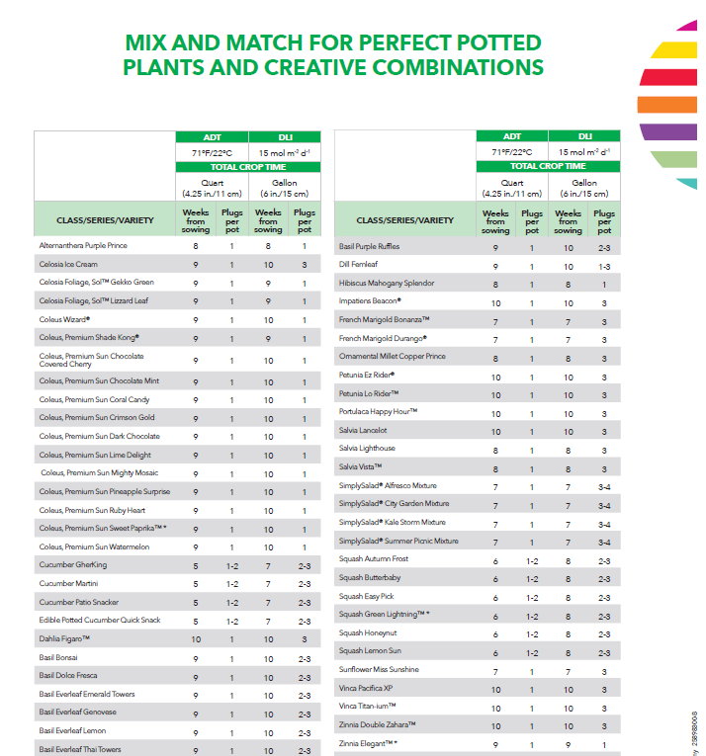


Slide 13
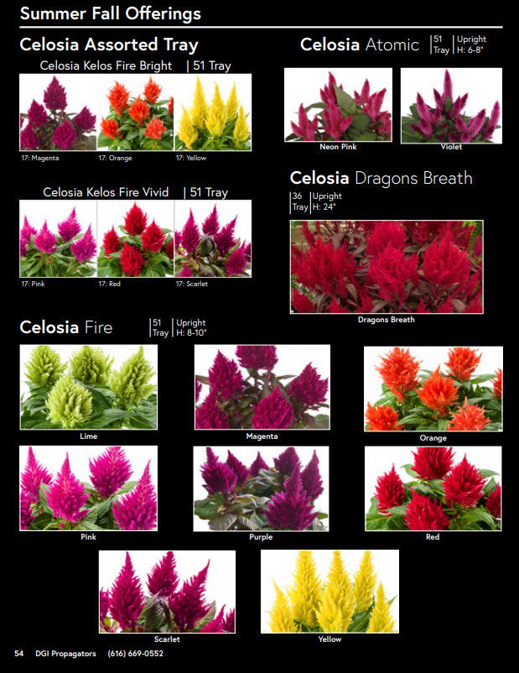
Celosia

Slide 14
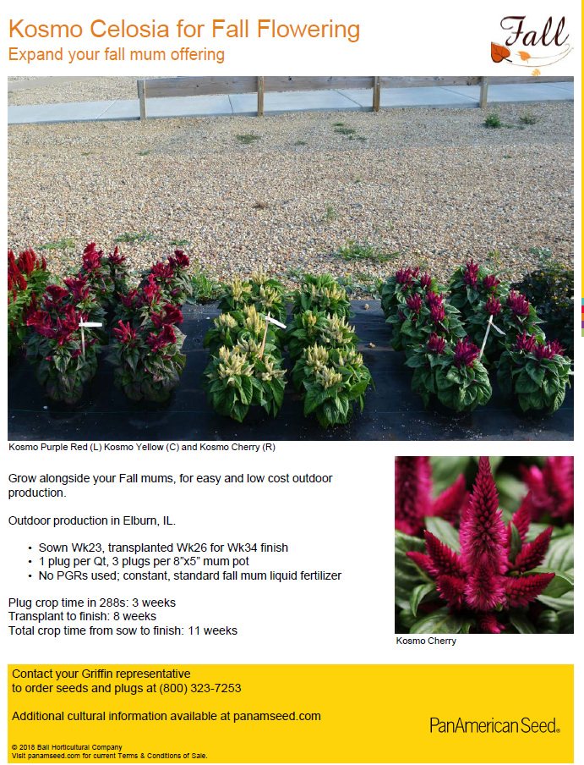
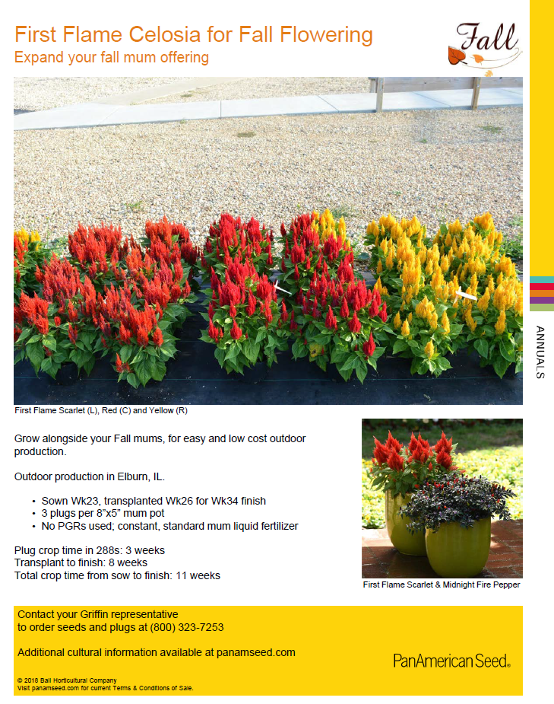

Slide 15
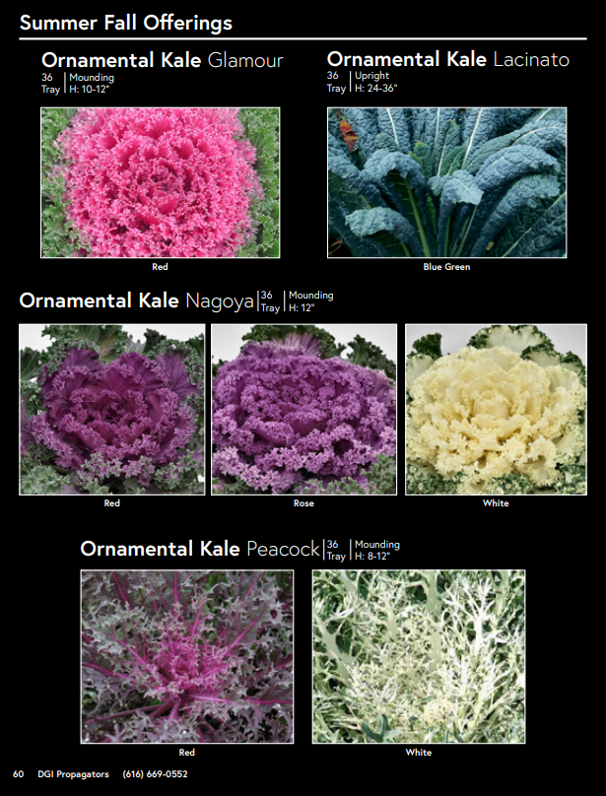
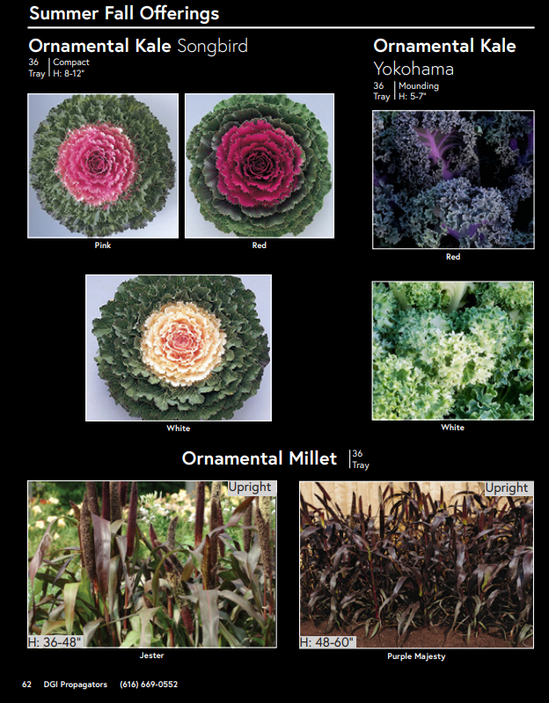
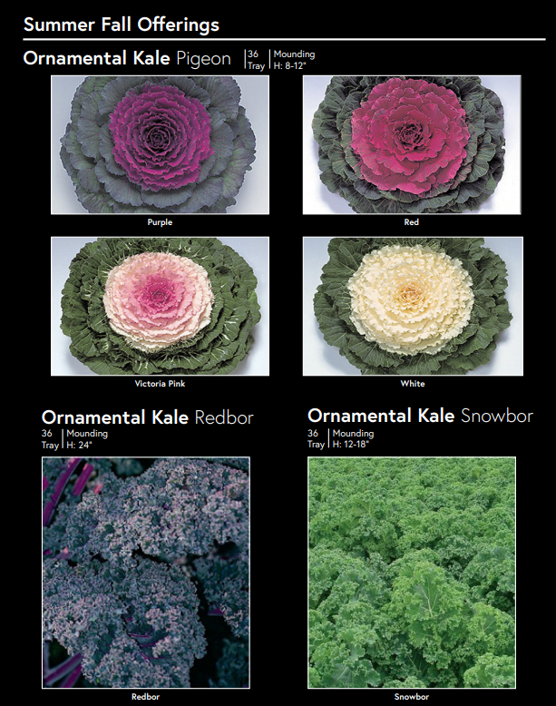
Ornamental Cabbage & Kale,

Slide 16
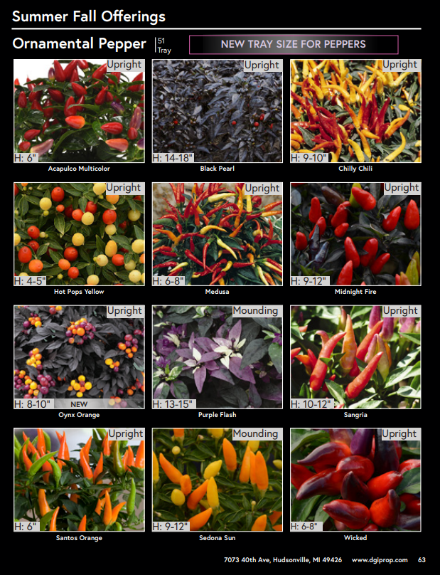
Ornamental Peppers

Slide 17
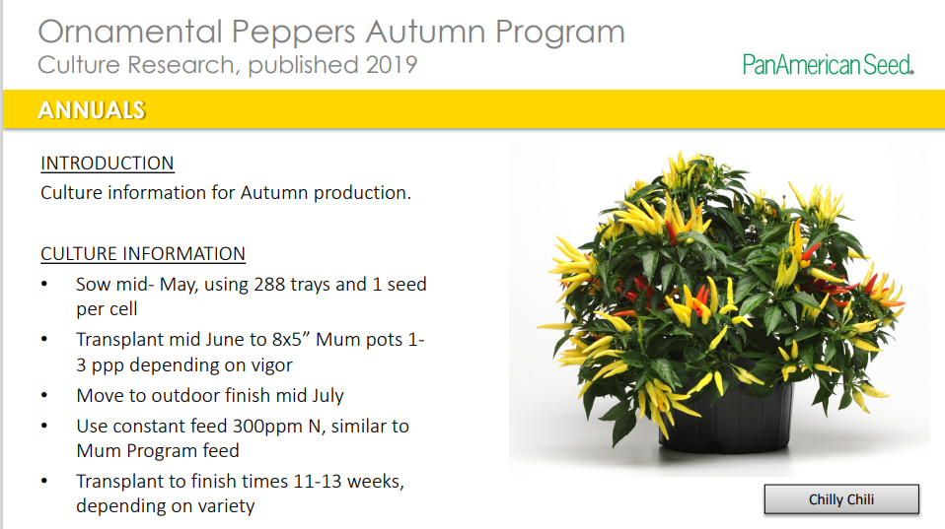
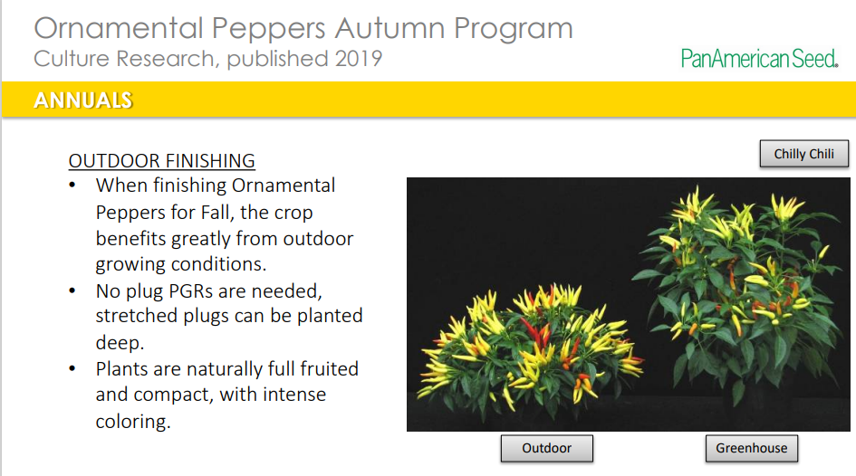
Ornamental Peppers Growing Info

Slide 18
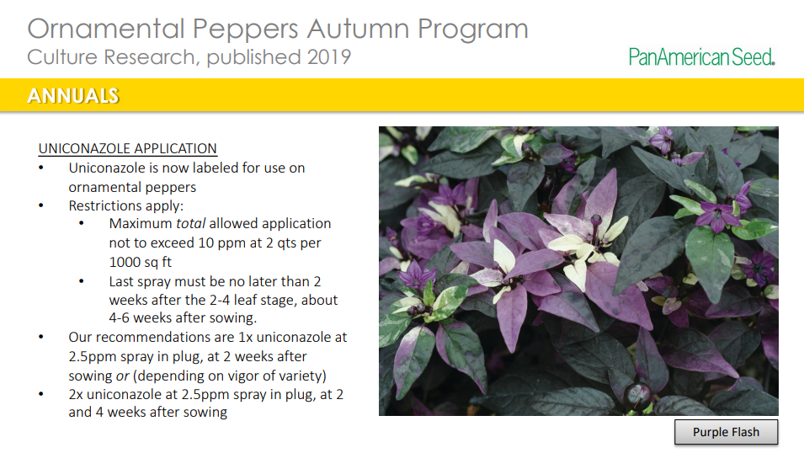
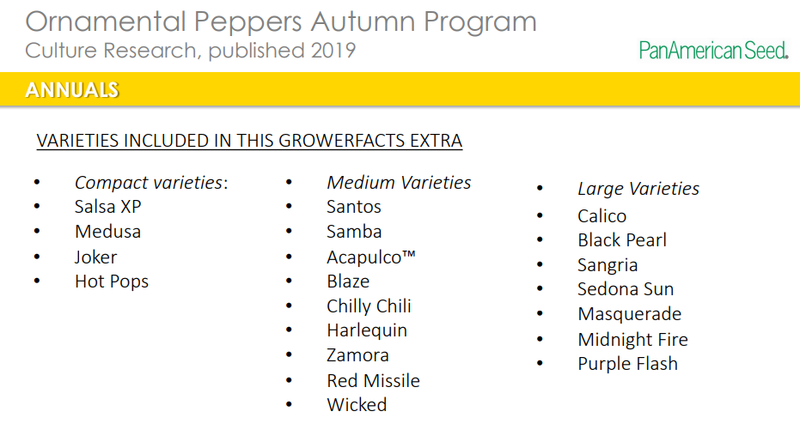
Ornamental Peppers– Growing Info

Slide 19
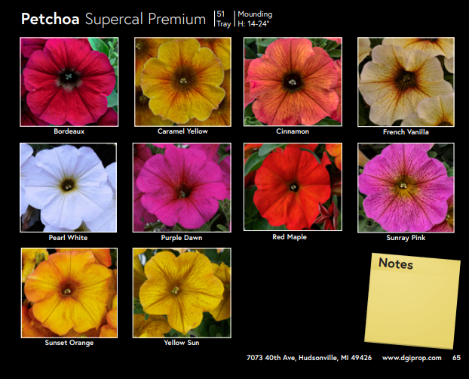
Petchoa, Petunia or Calibrachoa in Fall Colors

Slide 20
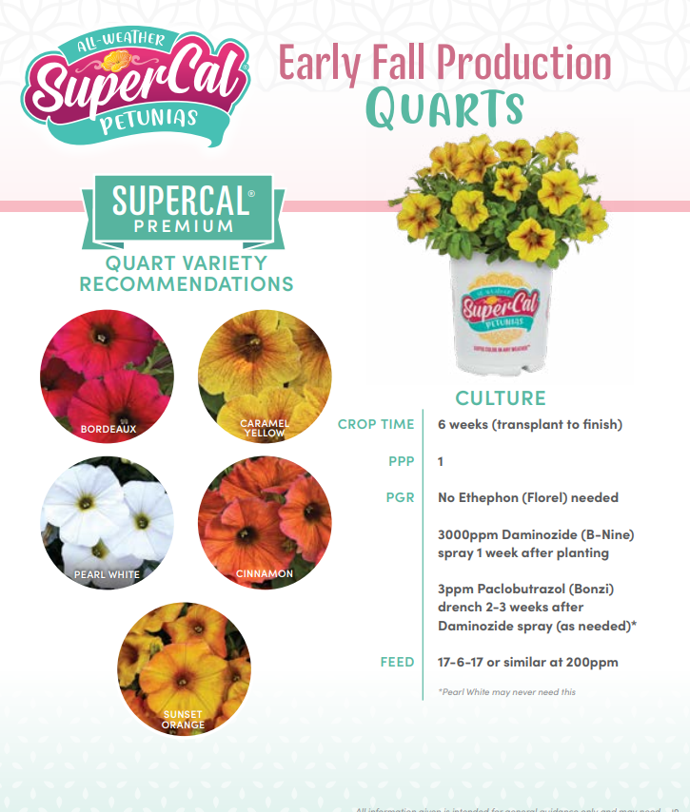
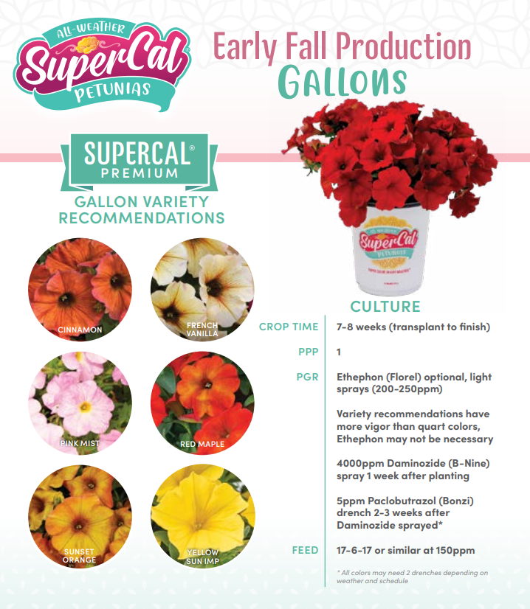


Slide 21
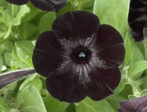
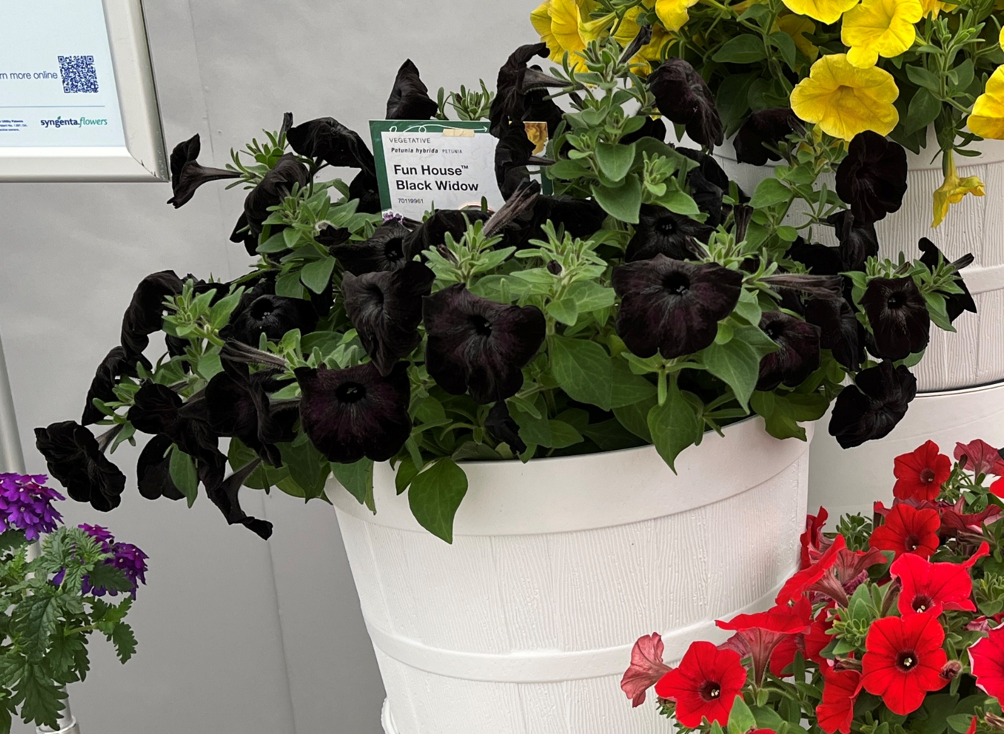
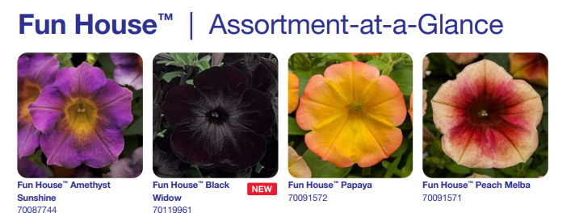
PETUNIA HYBRIDA Fun House™ Black Widow
Experience a burst of thrilling color! Funhouse is a collection, not a series, of unusual colors and patterns.
Vibrant petunias featuring unique flower hues and eye-catching patterns.
Ideal for hanging baskets and patio containers, adding a playful touch to any space.
Retailers adore these standout varieties that captivate consumers.
Full Sun
Early, Mid, Late Spring, and Summer
Mounding Habit
Medium Vigor
Dimensions 18-22” W x 10-14” H

Slide 22
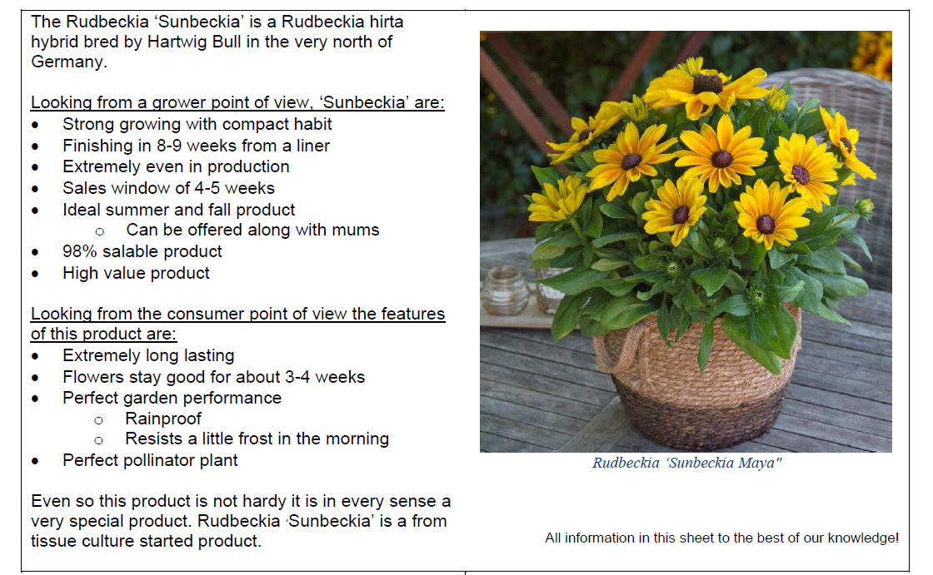
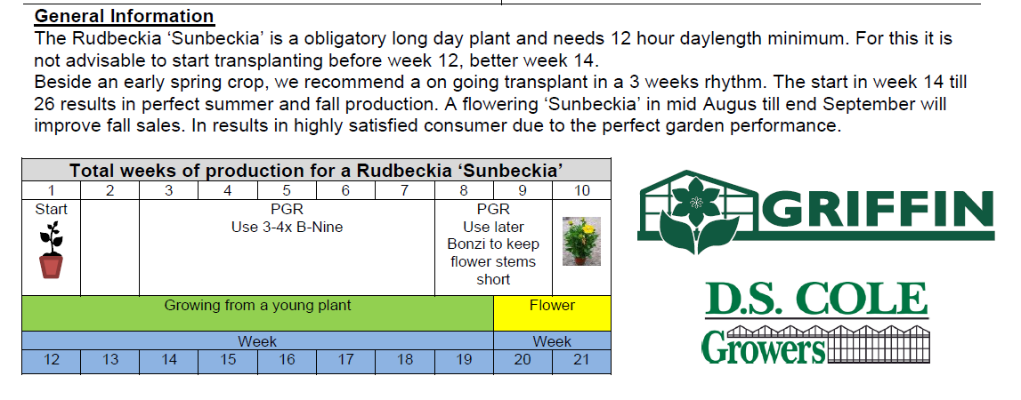
Rudbeckia Sunbeckia

Slide 23
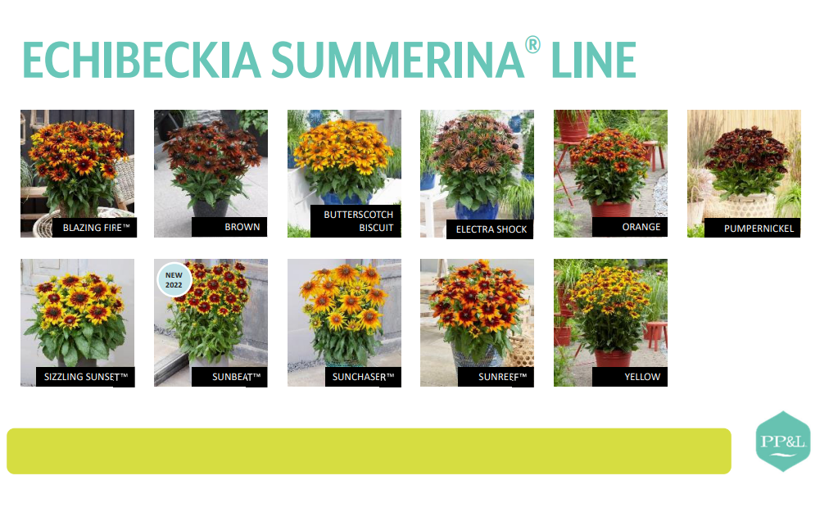


Slide 24
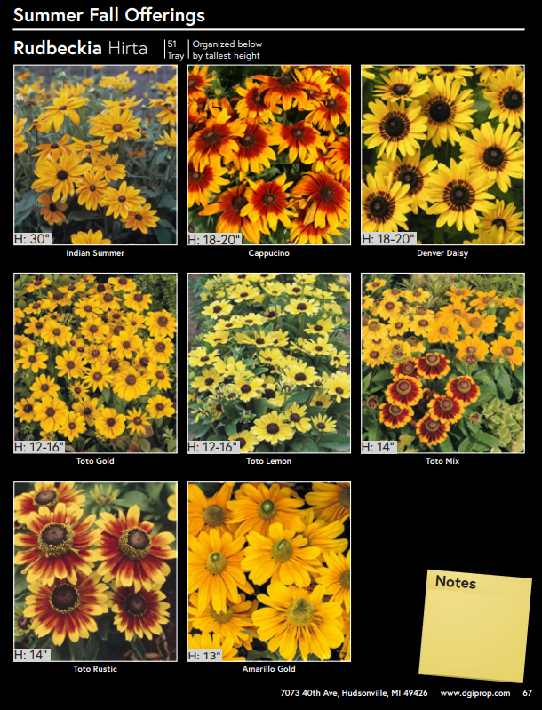
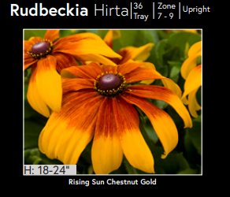
Rudbeckia Hirta

Slide 25

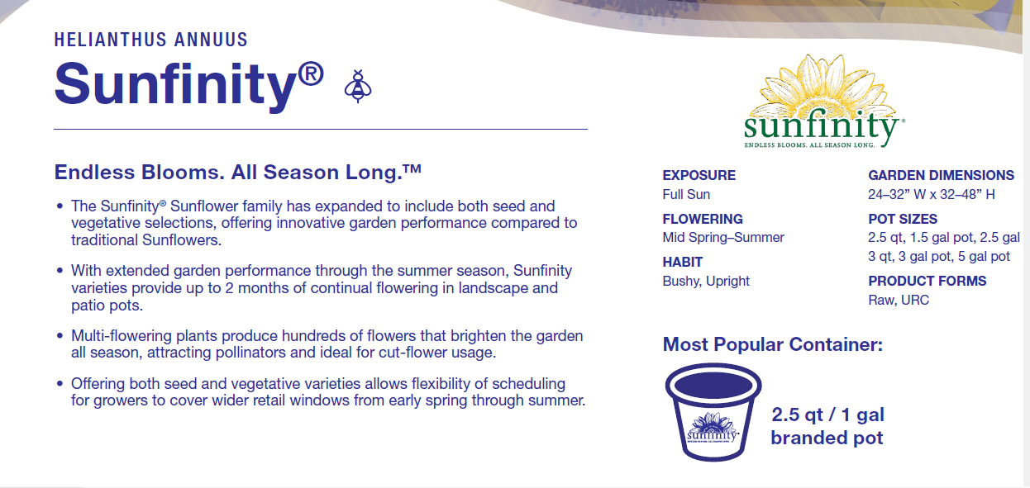
Helianthus Sunfinity

Slide 26
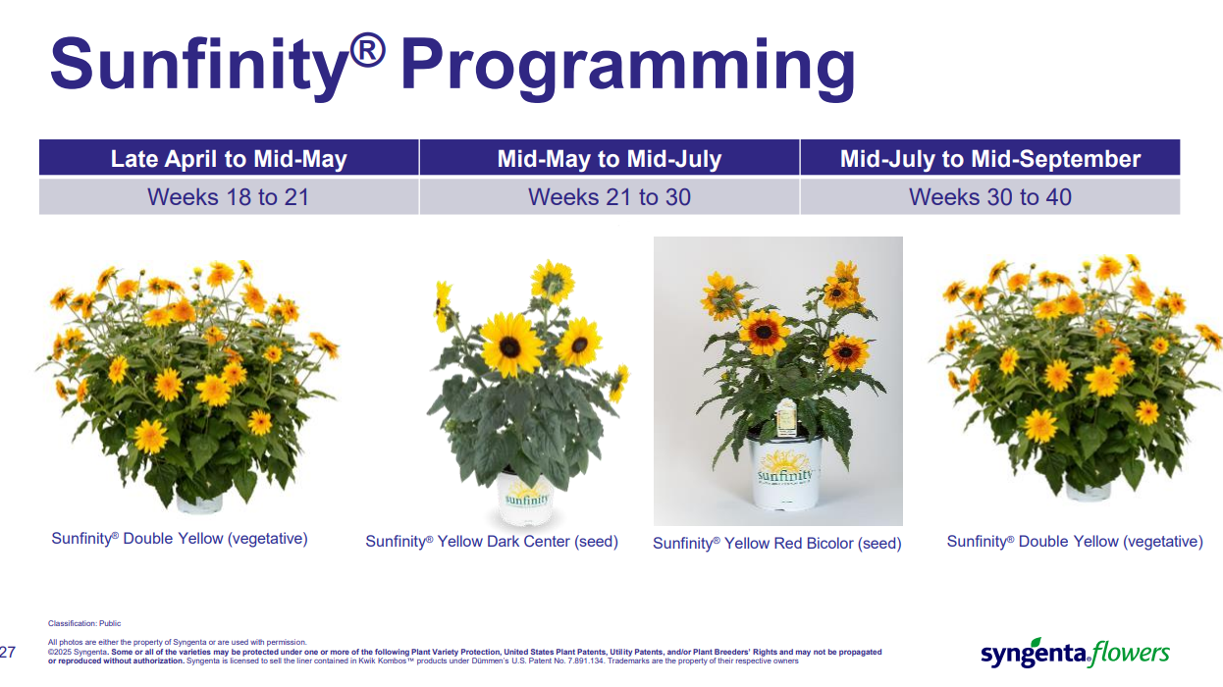

Slide 27
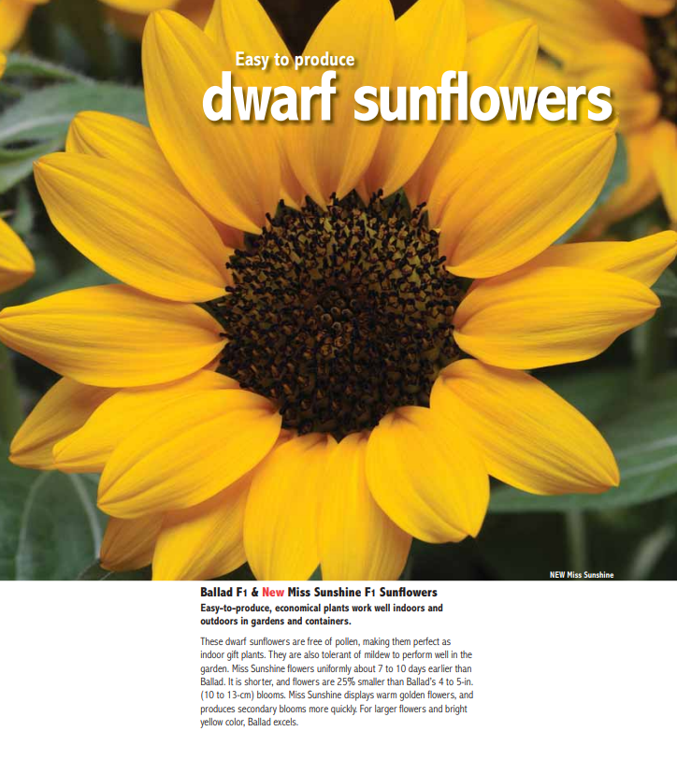
Sunflowers/ Helianthus

Slide 28
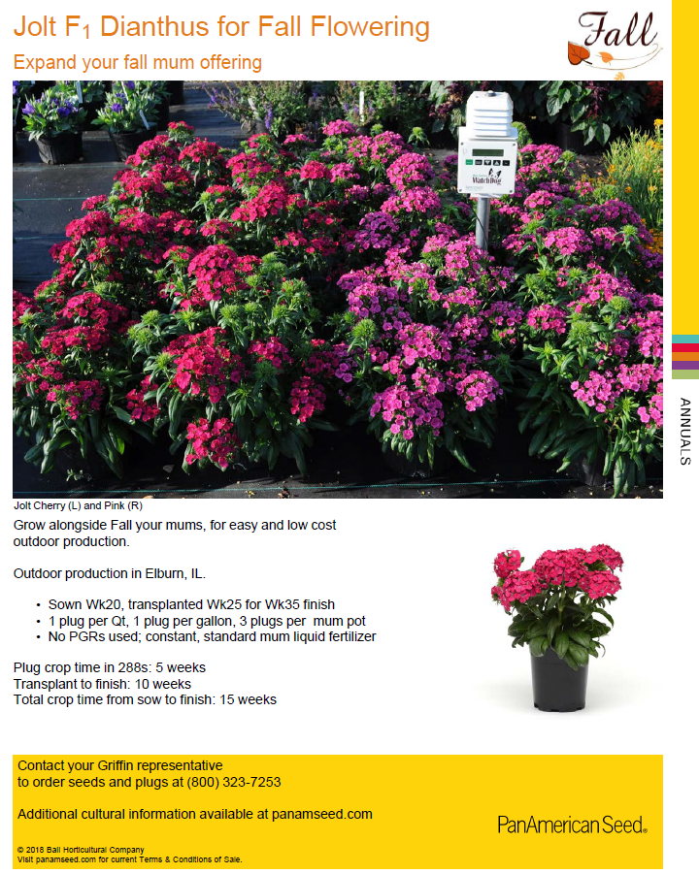
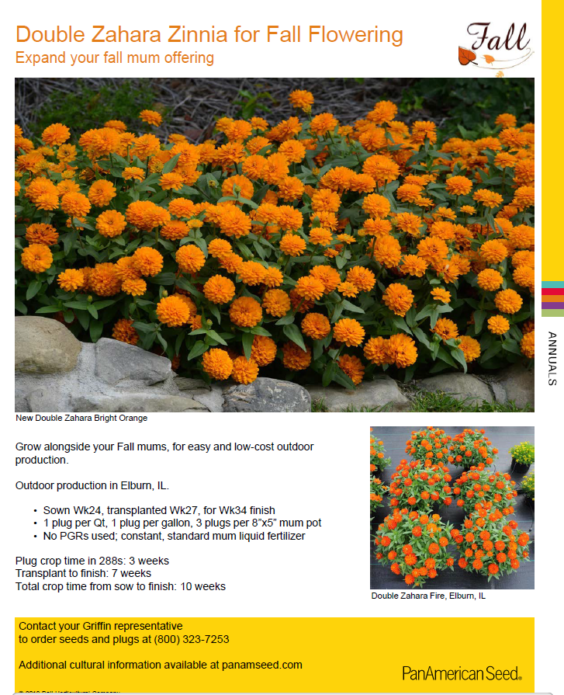

Slide 29
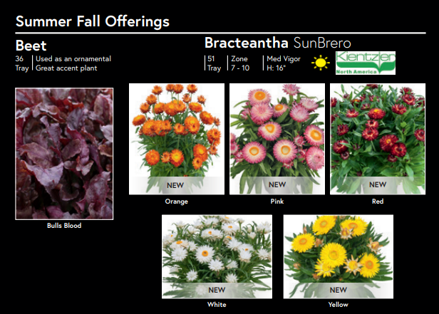

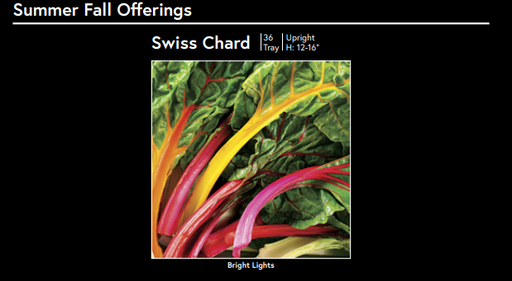

Slide 30
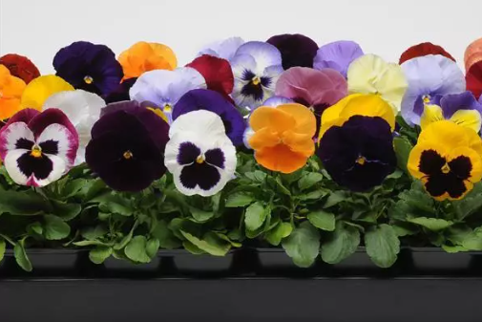
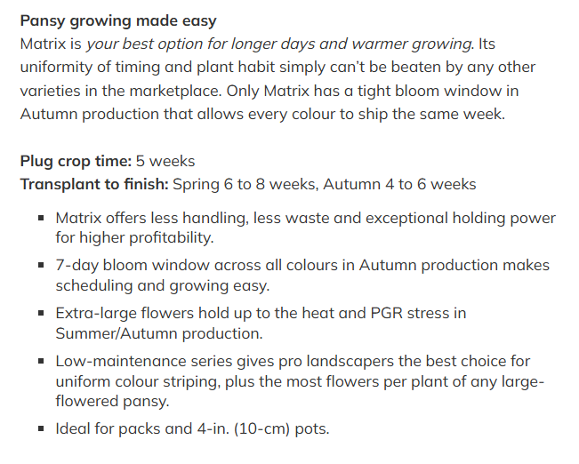
Pansy Matrix® for Fall

Slide 31
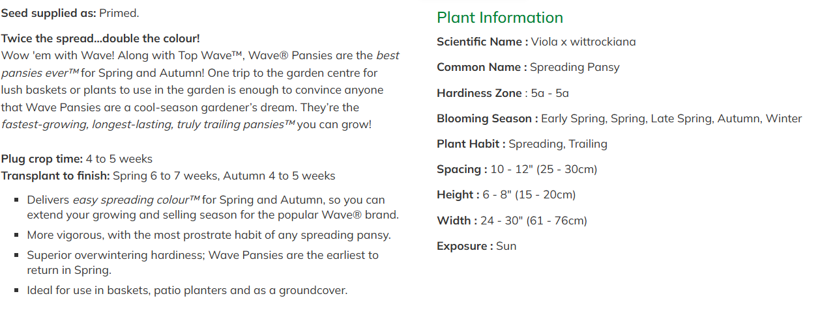
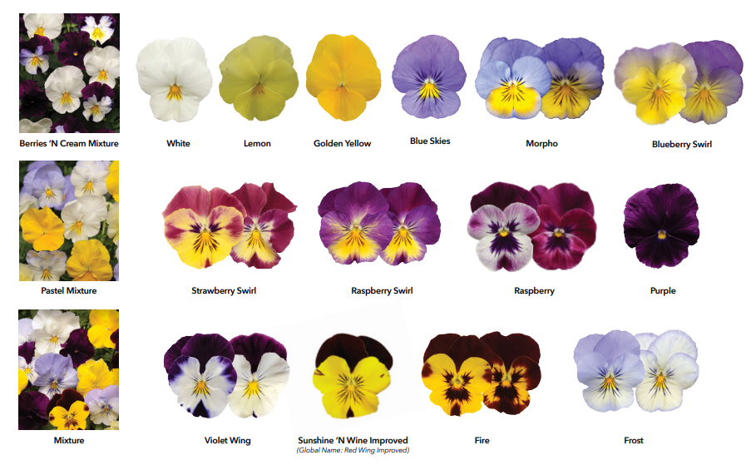
Cool Wave Pansy

Slide 32
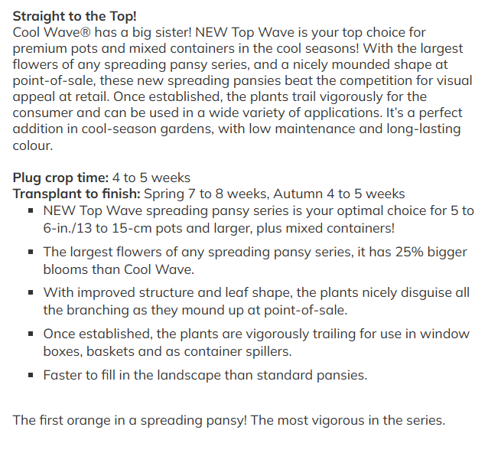
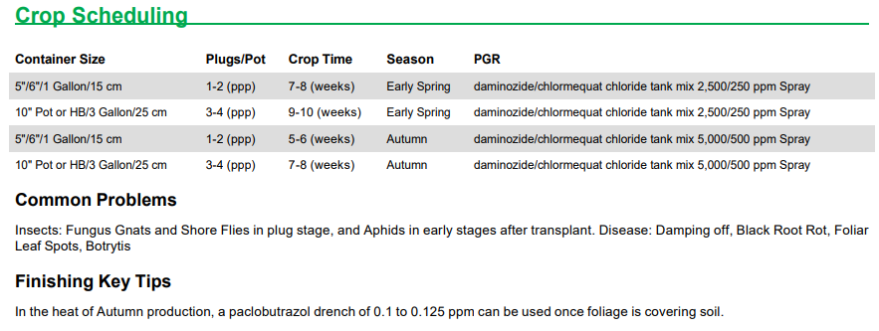
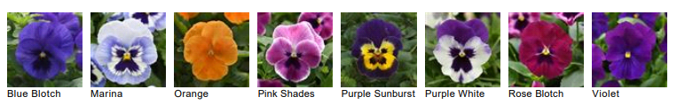
Top Wave Pansy

Slide 33


Pansies for Fall

Slide 34

Snapdragons

Slide 35


Snapdragon Sweet Duet ™
Experience the perfect blend of fragrance and beauty. • This highly fragrant series features stunning, large double flowers in vibrant colors, ensuring strong retail appeal. • Boasting a robust, well-branched structure with abundant secondary blooms. • Ideal for landscapes and premium containers in late spring, early summer, and fall programs
Flowers 1.5 weeks faster when finished under warmer temperatures 76F vs cool 62.5F
Part Shade-Full Sun
Flowering- Late Spring-Fall
Upright Habit
Garden Dimensions- 10-14”W x 18”22”H
2.5 qt to 1.5 gal container

Slide 36
Grasses & Millet

Slide 37


Pennisetum Rubrum

Slide 38

Grasses

Slide 39

Ornamental Millet

Slide 40
Perennials

Slide 41


Echinacea – Cone Flowers

Slide 42

Heliopsis

Slide 43




Heuchera Heureka
Beneficial to hold and bulk in a larger plug, vernalization is not required. Can hold at 40F once rooted
Mix and Match for Combos
Zone 5 hardy
Heureka Medium has 5 colors, Compact has 3

Slide 44


Leucanthemum

Slide 45



Sedum Autumn Joy and other Sedum spectabile

Slide 46
Summer/Fall Catalog Links
https://dgiprop.com/wp-content/uploads/2024/10/DGI-2025-Summer-Fall-Catalog-Final-for-website-10-28.pdf
2025 Mast Young Plants Mum Catalog
2025-Plantpeddler-Second-Season-Catalog.pdf
SFW_24_Online – Lucas finished for summer fall for 2024 but helpful for options

